Slide 1
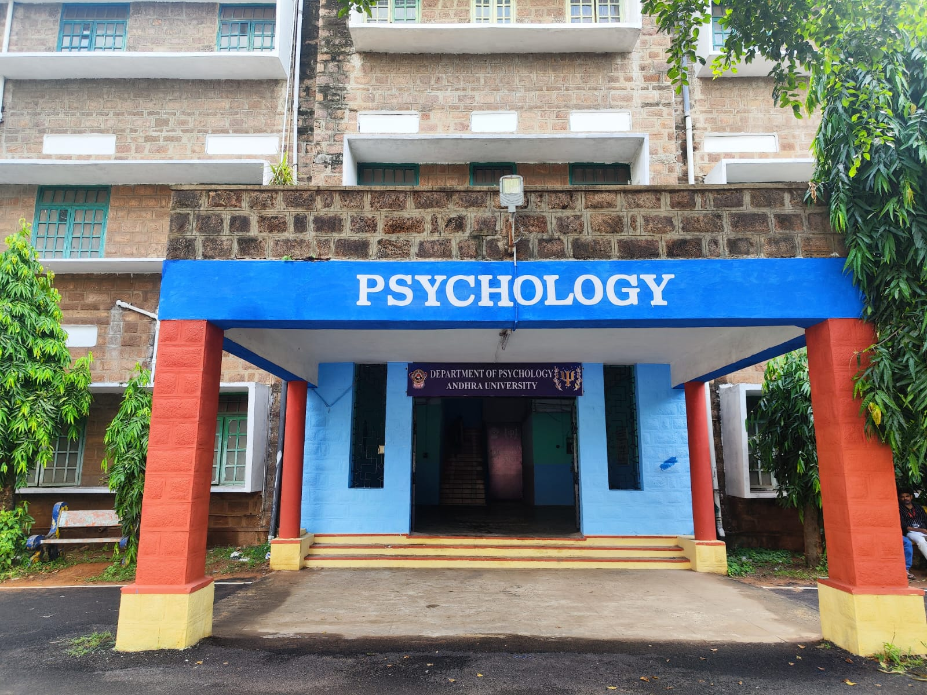
WELCOME TO NAAC PEER TEAM
Department of Psychology,
Andhra University,
Visakhapatnam.
Presented by
Senior Prof MVR RAJU

Slide 2
OVERVIEW
Vision & Mission
Department Profile/History/Achievement
Curricular Aspects
POs and COs
Teaching & learning
Research, Innovation and Extensions
Students support and Progression
Infrastructure and learning resources
Governance, leadership and Management
Institutional values and best practices
Progressive Plan

Slide 3
VISION
The department for Health and Counseling Psychology at the Andhra University aspires to be a Connoisseur in Psychology, where the students, research scholars and faculty are to engage in excellent teaching, research, extension services and collaboration to make significant contributions to the theory and practice of psychology and to produce competent professionals who serve the society for the promotion of health and well-being.

Slide 4
MISSION
To promote high academic standards in psychology by creating an optimal and enriching learning environment, fostering ongoing professional and personal development and contributing effectively to society’s needs.

Slide 5
DEPARTMENT PROFILE
Department of Psychology was established in the year 1967
Prof. K. Ramakrishna Rao was the founder professor.
First Indian Parapsychology department in India.
First Dream Laboratory in India.
The department, since inception has been working in Tune with the mission of university to promote Teaching, Research and Extension.
The department produced various fields of Research in psychology like Parapsychology, Sleep and Dreams, Health, Counseling, Organizational Behavior, Disability and Social.
The department organizes international conferences, Seminars, Workshops and Training Programs.
The department completed several projects sponsored by UGC, ICSSR, SAKSHAM, UNIVERSITY HOSPITALS GENEVA, ANRAK ALUMINI LIMITED, APSACS/NACO, HPCL, Regency Ceramics Limited and Visakhapatnam Steel Plant.

Slide 6
ACHIEVEMENTS
Prof K. Rama Krishna Rao received D.litt, Padma Shri(2011) and ICSSR fellowship.
Chairman, ICPR ( 2006 to 2012), Former Vice-Chancellor Andhra University
Dr V.V.GIRI, Former President Government of India, Visited Dept of Psychology.
Chancellor Kumudben Manishankar Joshi , Former Governor of Andhra Pradesh, Visited Dept of Psychology, 26 November 1987.
Dr Abdul Kalam, Former President of India , Visited Dept of Psychology(2007) as Chief Guest for Gerontology International Conference.
Prof Rani Ravi Kumar, Former Director IIM Bangalore.
Dr V. Sharada, CEO, A Tender Love & Care, FFA, USA.
Prof MVR Raju – Andhra Pradesh Honorable High court of Judicature appointed as Expert Psychologist for D.V. George(2008).
Visiting Faculty, Japan Advanced Institute of Science and Technology, Tokyo JAPAN. January 18-27th, 2009 sponsored by Japan.
Visiting Faculty, University of Kassel, Fachbereich Sozialwesen, D – 34109 Kassel, From 3rd June – 10th June 2005. Germany
Academic committee member in national institute of Public Cooperation and child Development, New Delhi- 1997-1999.

Slide 7
HISTORY AND ACHIEVEMENTS
Project Director (Faculty in charge) Saksham & GFATM R7, Department of Psychology, Andhra University, Visakhapatnam. 2013-17 – 1.2crore.
Director APSACS (NACO), Visakhapatnam, funded by Government of Andhra Pradesh, 2013-2017 – 50lakhs.
Prevalence of somatic symptoms, Mental health and Quality of life of Tribes in Araku Valley: Development of culturally Relevant Psychological Intervention”, funded by ICSSR, 2013-2015- 10 lakhs
Behavior Technology research on Intellectual Disability and Effectiveness of Neuro-Biofeedback as intervention technique, sponsored by Anrak Aluminum Limited, Visakhapatnam, 2012-2013, 5 Lakhs
Major project of Validation of Aberrant Behavior Check List – sponsored by Department of Adult Psychiatry, University Hospitals of Geneva, 2008-09, 2 Lakhs
Psychosocial interventions for Motivating Absentee Students of Andhra University, Visakhapatnam, Andhra Pradesh. Sponsored by University Grants Commission, New Delhi.2005-2007.
Psychological Counseling for Absentee Employees, Hindustan Petroleum Corporation Limited (H.P.C.L.), Visakhapatnam. 2002
Employees Performance Appraisal, Regency Ceramics Limited, Yanam, Pondicherry. 2003, 5 Lakhs
Employees Performance Appraisal, Regency Ceramics Limited, Yanam, Pondicherry 2004, 5 Lakhs

Slide 8
RECOGNITION
Chairman, NAAC PEER COMMITTEE, 2023.
The Andhra Pradesh Honorable High Court of Judicature appointed as Expert Psychologist for D.V. George (2008).
UPSC Advisor and Confidential 2001 to Till Date
UGC NET Paper Setter, 2009 to Till Date.
ICSSR Confidential 2014 to Till Date
Andhra Pradesh Public Service Commission (APPSC) Confidential2004-06.
OPSC Orissa Public Service Commission Confidential, 2006-2008
Staff Selection Commission (SSC) Confidential, 2001
Academic Committee Member, Board of Intermediate Education, Hyderabad. Andhra Pradesh from 2003 onwards.
Family Counseling Sub-Committee Member in Family Counseling Center, Priyadarshini Service Organization, a non-profit Re g. Voluntary organization, Visakhapatnam. (Funded by Ministry of Women and Child Welfare, Govt. of India, New Delhi). 1998.

Slide 9
CURRICULAR ASPECTS
PG PROGRAMMES
M.Sc. (Psychology)
DOCTORAL PROGRAMMES
Ph.D. (Psychology)
VALUE ADDED PROGRAMMES: IPR, Research Methodology
Centre for Psychological Assessment and Counselling.
(Free service for university employes research scholars, students and outside the community-judiciary and police)
OBE framework: our curriculum based on OBE framework with regard to national, sate and community.

Slide 10
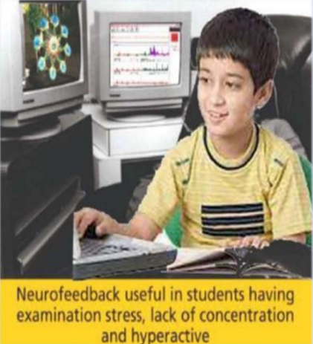
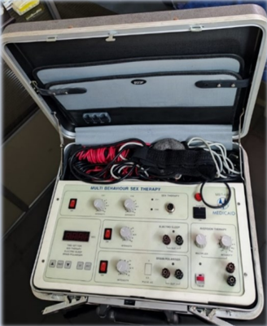
Centre for Psychological Assessment and Counselling
Neurobiofeedback, or neurofeedback, is a captivating area of biofeedback that entails the live monitoring and control of brain activity.
This program employs auditory or visual cues to aid individuals in identifying their thought patterns and attempting to adjust them.
Neurobiofeedback
Multi behavioral sex therapy
Multi-behavior sex therapy is a comprehensive approach to addressing a wide range of sexual issues and concerns. It involves a holistic assessment of psychological, emotional, physical, and relational factors contributing to sexual difficulties.

Slide 11
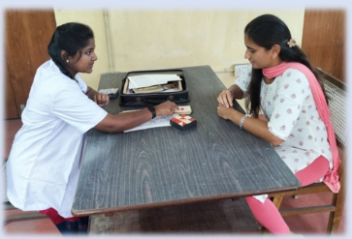
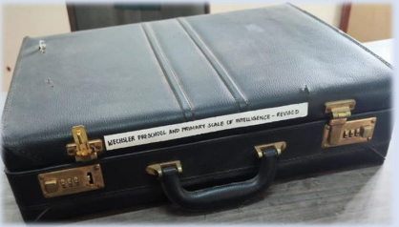
Learning disabilities
A learning disability is a neurological condition that affects the way an individual learns, processes, and uses information. These disabilities can impact skills like reading, writing, math, or problem-solving.
Learning disabilities are not related to intelligence, and with the right support and strategies, individuals with learning disabilities can achieve success in their education and daily life. Early signs of learning disabilities can vary depending on the specific type of learning disability a person may have.

Slide 12
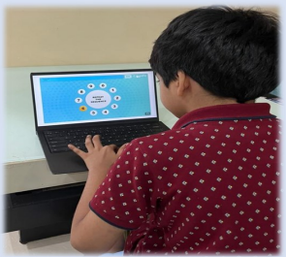
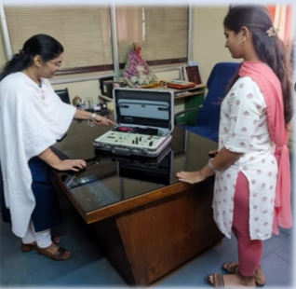
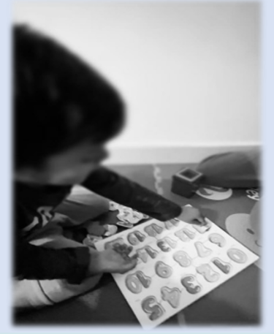
Digital Cognitive Therapy
Digital cognitive therapy delivers evidence-based CBT through online platforms, enabling users to access interactive lessons and self-guided or therapist-assisted content for improved mental well-being, offering convenience and cost-effectiveness.
STRATEGIES AND INTERVENTION
Individualized Education Plan (IEP)
Structured Environment
Multi-Sensory Instruction
Peer Tutoring
Positive Reinforcement

Slide 13
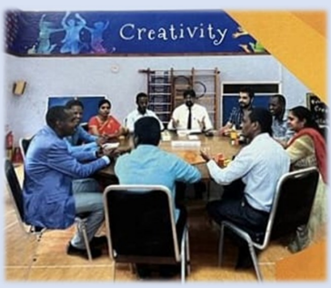
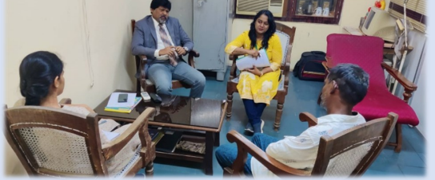
group counselling
Group counseling addresses mental health and personal growth needs, fostering mutual support and skill development in a structured, supportive environment for individuals with common concerns or goals.
POCSO AND JUVENILE COURT TRIAL CASES
Psychological Centre for Assessment has Conducted counseling for several Juvenile cases that are brought to our department by the stater police department.

Slide 14
MSc Psychology Syllabus
I YEAR | II YEAR
Semester-1 101 Emergence of psychology and personality 102 Life Span Development 103 Physiological Psychology 104 Psychometrics 105 Psychometrics practical's | Semester-3 301 Positive Psychology 302 Community Psychology 303 Counselling Psychology 304 Health Psychology 305 Case Studies
Semester-2 201 Social Psychology 202 Clinical Psychology 203 Research Methodology 204 Cognitive Psychology 205 Cognitive Psychology Practical’s | Semester-4 401 Forensic Psychology 402 Industrial and Organization Psychology 403 Educational Psychology 404 Disability and Rehabilitation Psychology 405 Project

Slide 15
STUDENTS CASE STUDIES:
III Year students completed their case studies in collaboration with the following institutions and submitted the Case reports as a part of curriculum:
Govt. Hospital for Mental Care, Visakhapatnam
Central Jail, Visakhapatnam
Juvenile Home, Visakhapatnam
A. U High School, Visakhapatnam
Disability Centers( Lebenshelf and Pavani Institute of Mental Care, Visakhapatnam )
STUDENTS Projects :
Final Year students completed their Project works in collaboration with the following Companies and submitted the Project reports as a part of curriculum:
Vizag Steel Plant, Visakhapatnam
RVNLl, Visakhapatnam
Visakhapatnam Port Trust, Visakhapatnam
HPCL, Visakhapatnam
Bharat Petroleum Corporation, Visakhapatnam

Slide 16
LABORATORIES
Digital Computer Laboratory
Psychological Testing Laboratory
Cognitive Psychology Lab
Disability Laboratory
Neuro-Physiological Laboratory
Departmental Library

Slide 17
POs
PSO1: To create a strong research oriented theoretical foundation in consonance with recent advances in the discipline of psychology.
PSO 2: To enable students to take a creative, empirical and ethical approach to the program that combines conceptual repertoire and research practices in both quantitative and qualitative traditions.
PSO 3: To provide an opportunity to extend the knowledge base to the world of practice with a view to promote healthy interface between academia and society.
PSO 4: Characterize the nature of psychology in science and applied settings.
PSO 5: Demonstrate psychological literacy and incorporate theoretical, statistical and experimental methods in scientific inquiry.
PSO 6: Deepen comprehensive knowledge of psychology’s core foundation content domains, especially of cognitive, social, developmental psychology, and the biological bases of behavior.
PSO 7: Formulate plausible psychological explanations for behavioral phenomena and develop scientific hypotheses.
PSO 8: Produce innovative and integrative applications to solve problems.
PSO 9: Behave and conduct research in accordance with the ethical standards of the discipline.
PSO 10: Strengthen personal integrity and developing soft skills such as scientific writing and speaking, effective communication, teamwork, flexibility, and leadership.
PSO 11: Exercise values that reflect a commitment to diversity and contribute to society.
PSO 12: Apply psychological knowledge and scientific thinking, writing, and speaking skills in professional settings
PSO 13: Develop advanced research designs and apply advanced statistical analyses.

Slide 18
COs
https://www.andhrauniversity.edu.in/course-syllabus.html

Slide 19
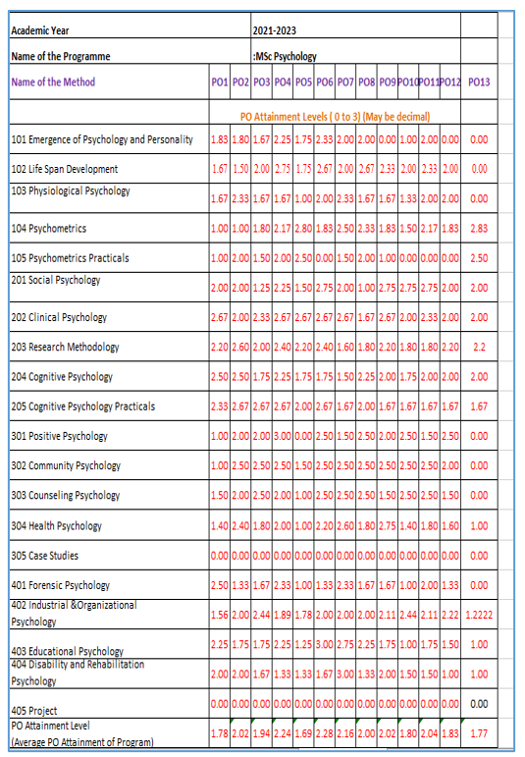
PO-CO Mapping

Slide 20
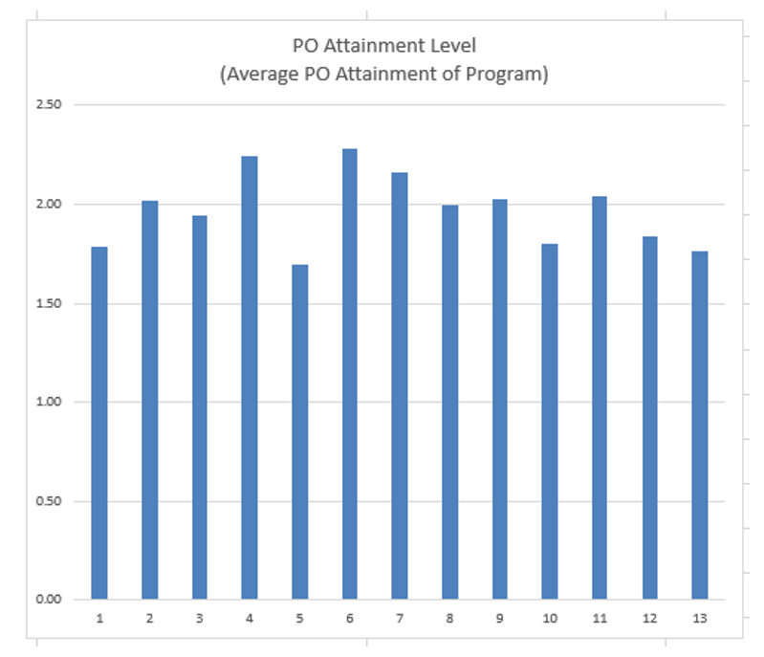

Slide 21
CO and PO attainment
Department of psychology and parapsychology has achieved remarkable 100 percent attainment of CO in correspondence to po’s envisioned.
The following reasons encompass procedures adapted to the attainment :
Subject goal oriented (i.e., Po’s) activities like field work (mental health care units visits for example), case studies where students will gain hands on experience on the subject being taught.
Extra-curricular programs: workshops relevant to enhance the knowledge of the students regarding subject were conducted adequately.
`Students are participating actively in academic activities such as psychological testing practicals and cognitive laboratory. This practical application of subject helped in attainment of the P ‘s successfully.
Regular seminar participation of all of the students in topics which are socially relevant but also of psychological significance, achieved enlarging students’ knowledge at the same the improved their confidence and communication skills.
Students who are absent for some reasons are given opportunities to recover the loss of the academic activities by providing relevant support.
Students are encouraged to participate in research project activities to inculcate research outlook in them.

Slide 22
DEMEND RATIO: M. Sc Psychology
Academic Year | No. Of Eligible Applications Received | No. Of Seats Admitted | Demand Ratio
2017-2018 | 5168 | 24 | 1:215
2018-2019 | 2562 | 30 | 1:85.5
2019-2020 | 2016 | 30 | 1;67.2
2020-2021 | 4397 | 20 | 1:209.4
2021-2022 | 4397 | 21 | 1:209.4

Slide 23
Result Analysis: M. Sc Psychology
Academic Year | Total Strength | First Class with Distinction | Second class | Total
2017-2018 | 24 | 03 | 05 | 08
2018-2019 | 30 | 05 | 11 | 16
2019-2020 | 30 | 06 | 16 | 22
2020-2021 | 20 | 07 | 12 | 19
2021-2022 | 21 | 07 | 13 | 20

Slide 24
STUDENTS STRENGTH AND DIVERSITY: M. Sc Psychology
Academic Year | Male | Female | Total
2017-2018 | 18 | 06 | 24
2018-2019 | 21 ( 2 International) | 09 | 30
2019-2020 | 20 | 10 | 30
2020-2021 | 10 | 10 | 20
2021-2022 | 4 | 17 (1 International) | 21

Slide 25
Academic Year | OC | BC | SC | ST | Total
2017-2018 | 08 (one foreign student) | 12 | 04 | - | 24
2018-2019 | 10 ( two foreign students) | 13 | 04 | 03 | 30
2019-2020 | 08 | 15 | 05 | 02 | 30
2020-2021 | 03 | 10 | 05 | 02 | 20
2021-2022 | 04 (one foreign student) | 10 | 05 | 02 | 21

Slide 26
STUDENTS CATERIZATION(ADVANCED LEARNERS/SLOW LEARNERS): M. SC PSYCHOLOGY
Academic Year | Advanced Learners | Slow Learners | Total
2017-2018 | 18 | 06 | 24
2018-2019 | 21 | 09 | 30
2019-2020 | 20 | 10 | 30
2020-2021 | 15 | 05 | 20
2021-2022 | 17 | 04 | 21

Slide 27
FEEDBACK FOR CIRRICULAM COLLECTED AND ANALYSIS REPORT
Feedback forms from the students is collected in each semester and sent to the IQAC office for analysis. The analysis report is distributed to the staff members.
Students
Faculty
Alumni Association
Employers
Curriculum

Slide 28
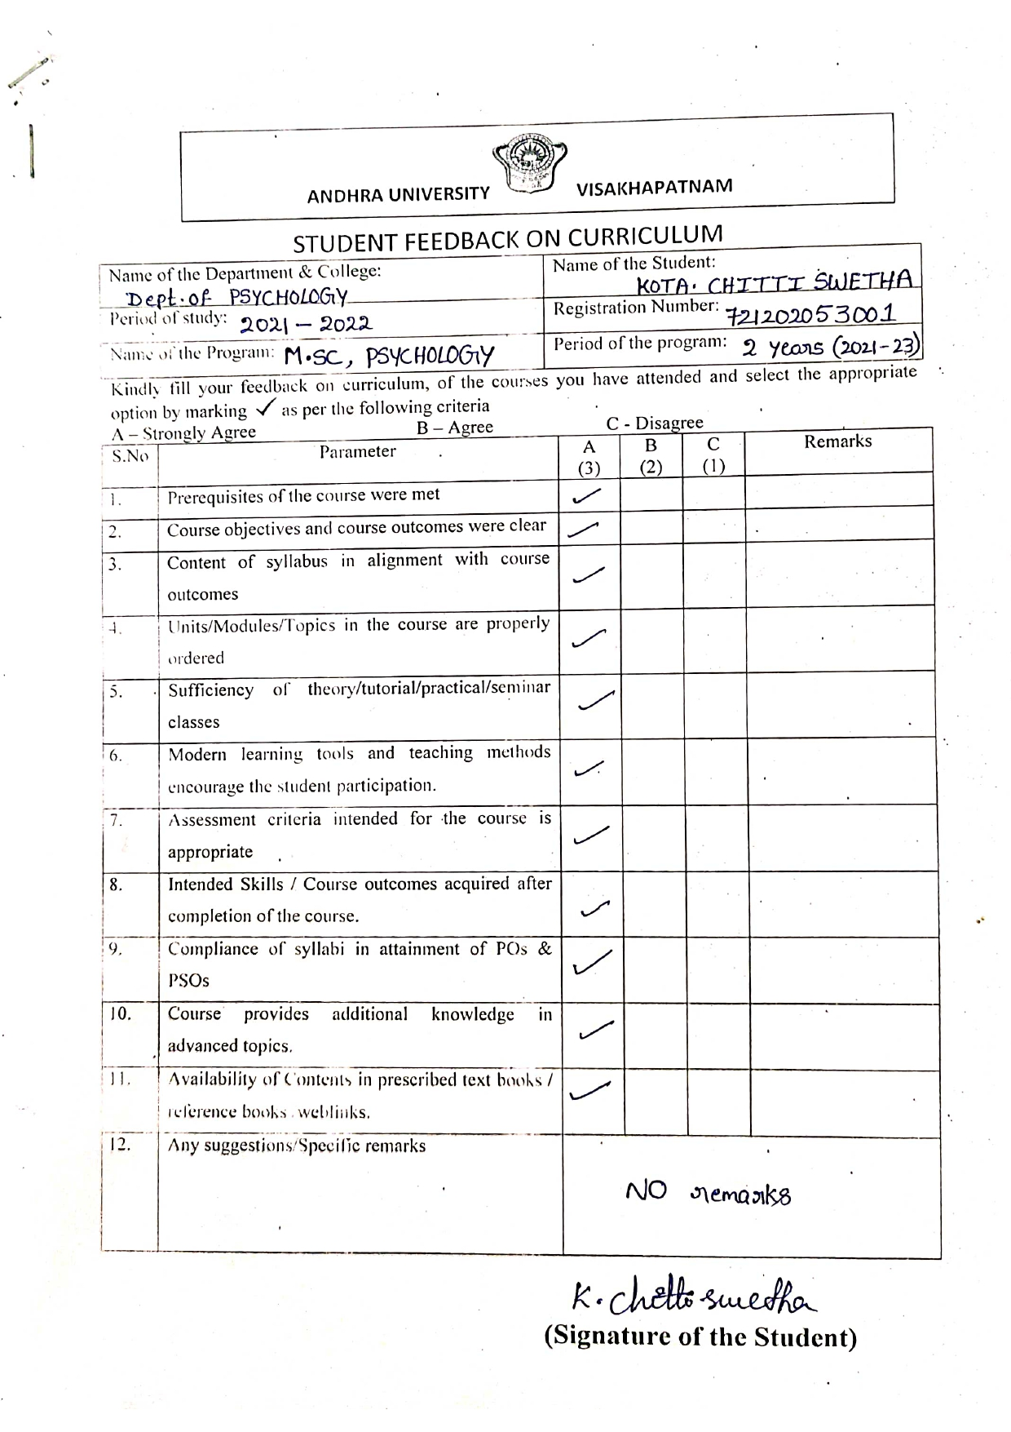
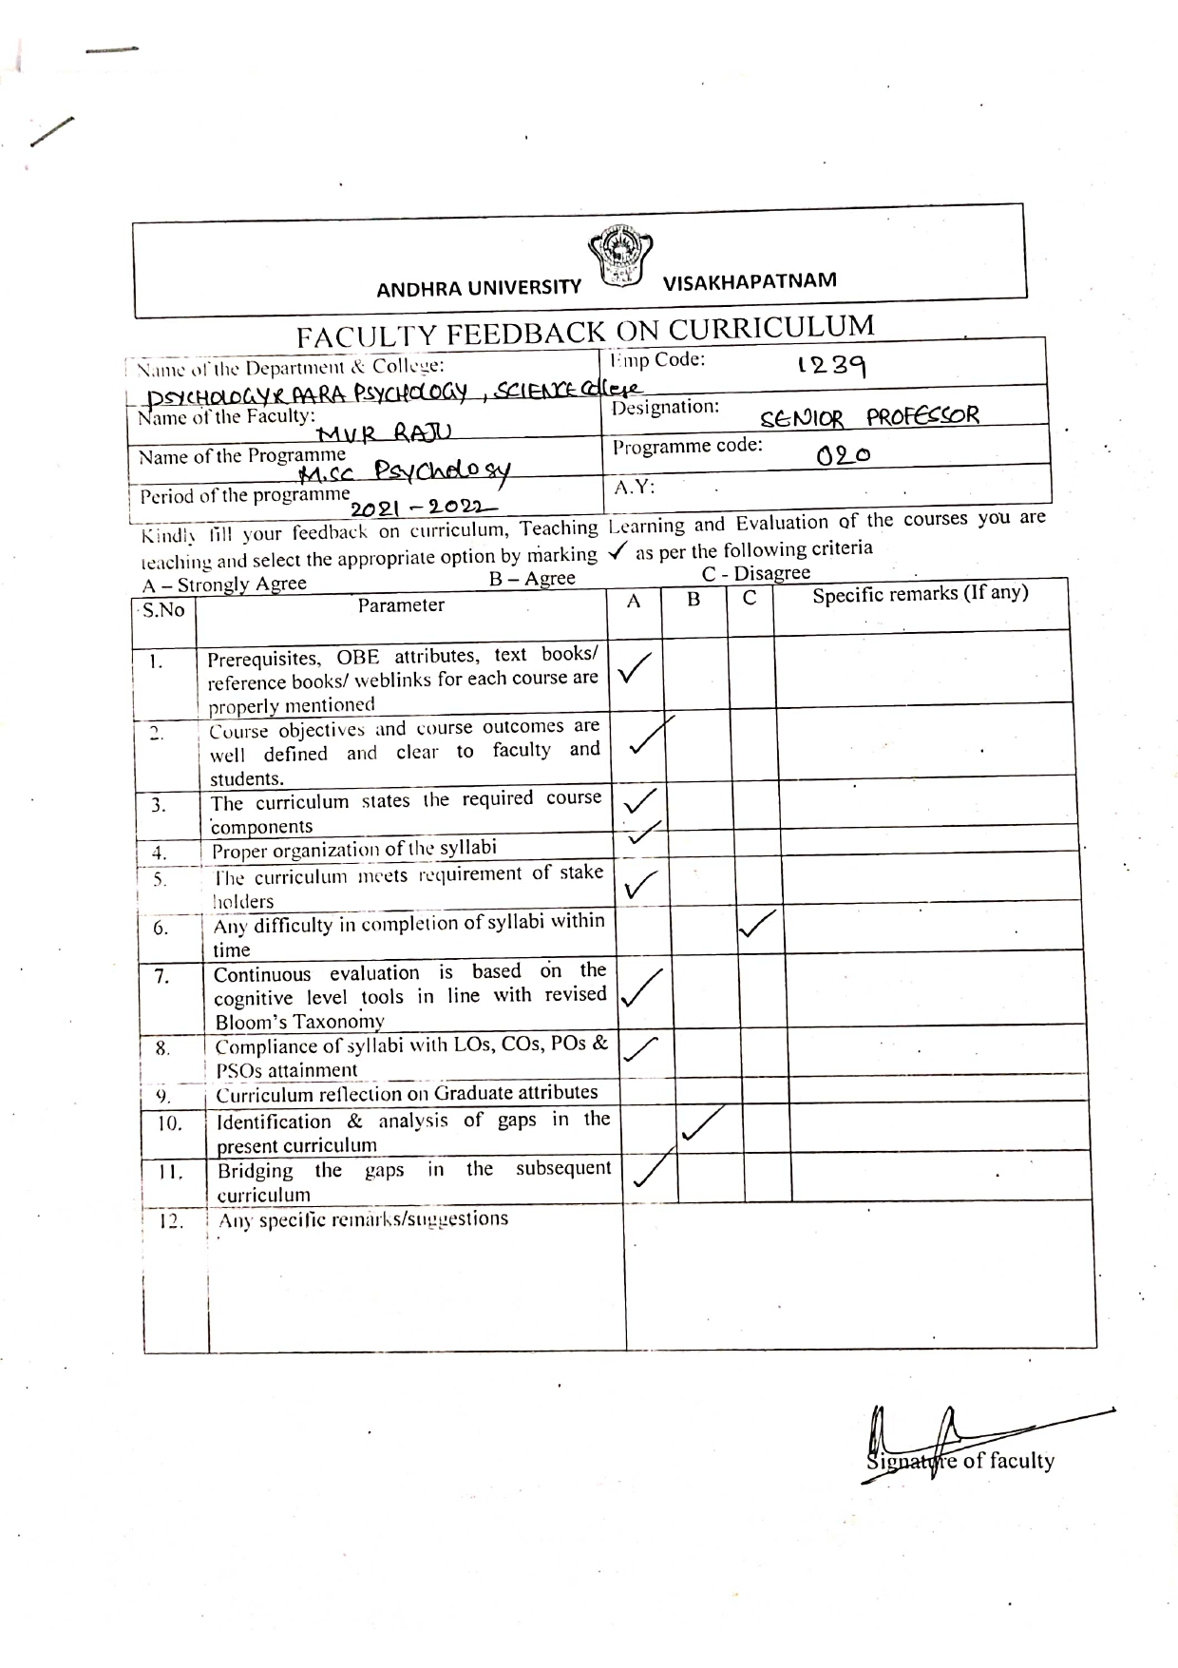
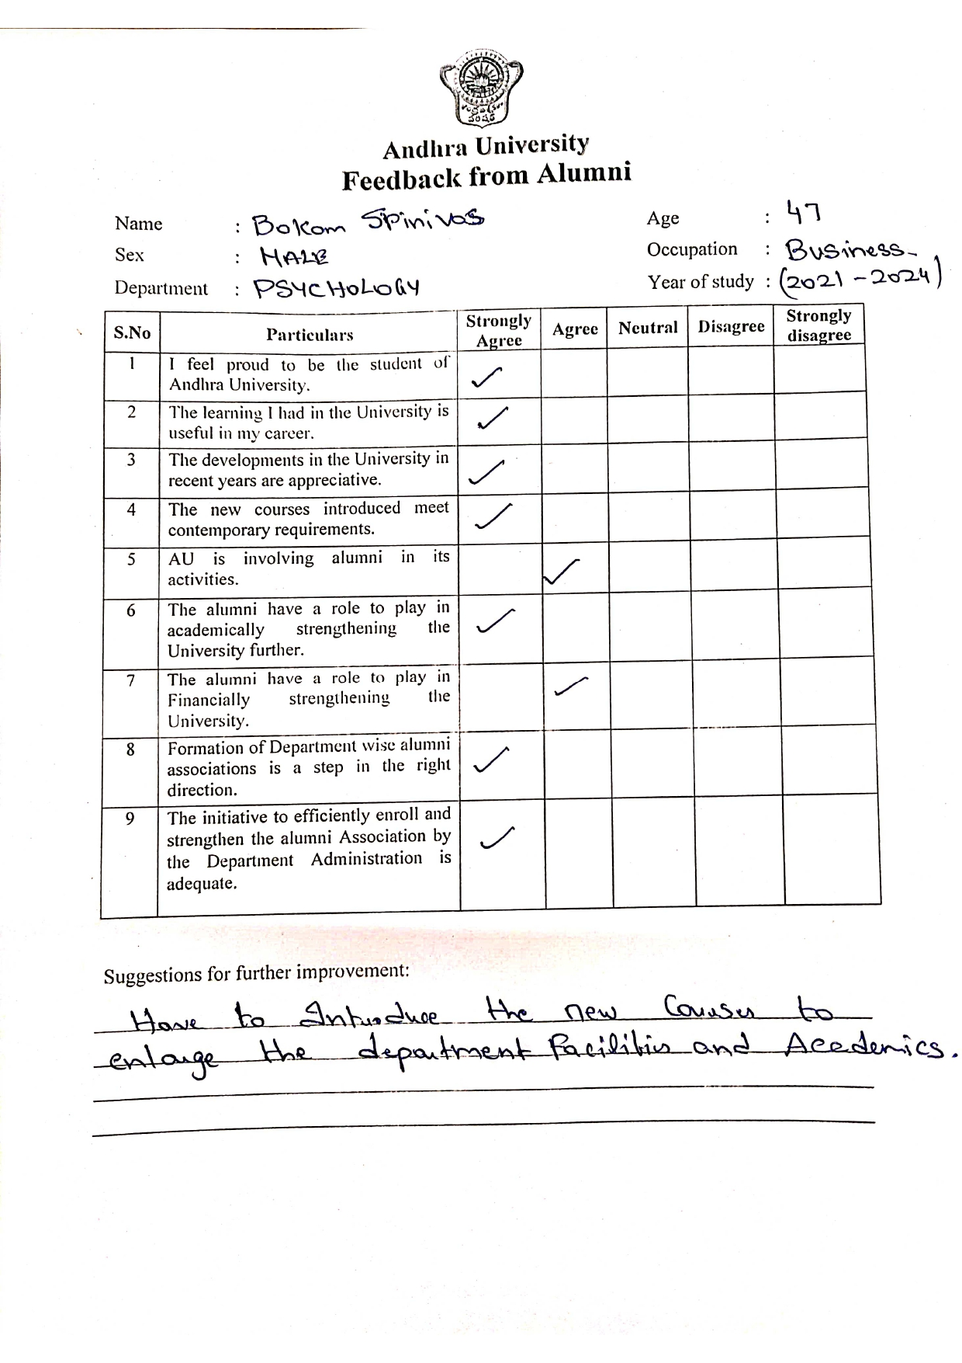

Slide 29
TEACHING AND LEARNING
FACULTY PROFILE FROM 2017-2022
S. No | Name of the Faculty | Destination
1. | Senior Prof MVR Raju | Senior Professor
2. | Prof. T. V. Ananda Rao | Professor
3. | Dr. S. Suneetha Kumari | Temporary Teaching Arrangement
4. | Dr. Rupaselvaraj | Temporary Teaching Arrangement
5. | Dr. D. Rajya Lakshmi | Temporary Teaching Arrangement
6. | Dr. B. Pavan Kumar | Temporary Teaching Arrangement
7. | Dr. G. Sarvani | Temporary Teaching Arrangement
8. | Dr. A. Subhashini | Temporary Teaching Arrangement
9. | Dr. PVV. Anjani | Temporary Teaching Arrangement
10. | Mr. V. Damodara Rao | Temporary Teaching Arrangement
11. | Dr. Balla Deepthi | Temporary Teaching Arrangement
12. | Ms. Ramya Kosuri | Temporary Teaching Arrangement

Slide 30
Dr. MVR. RAJU, Senior professor, Department of Psychology joined in the year 1990.
https://vidwan.inflibnet.ac.in/profile/244879
AWARDS: 16
Prof. K V Kaliappan Memorial Award 2020, for the Best Research Extension Work , IAAP, 2020.
Prof. SC Sharma Memorial Best Researcher Award 2018
Best School Trainer Award In SPA – 2017.
Best Research Award-2016, National institute of Technical Teachers Training Research (NITTR), IAAP conference at University of Rajasthan, Jaipur-2017.
The Platinum Jubilee Lecture Award (in Cash), Indian Science Congress, Ministry of Science and Technology, Mysore-2016.
President’s Gold Medal Award, Indian Psychological Association-2015
Life Time Achievement Award, for the “Teaching, Research, Guidance and Counselling in Psychology”, Surya’s Educational & Welfare Society,Vizianagaram-2014
Sigmund Freud Memorial Best Psychologist Award, Sri Ramakrishna Seva Samithi and Alliance International,Vizianagaram-2014
Prof. ANIMA SEN IAAP MEMORIAL AWARD, for the “Innovative Contribution and Research work” IAAP-2012
The State Best Teacher Award (Professor)Andhra Pradesh 2009
The Bestout Standing Contribution in Psychology, Andhra Pradesh Counseling Psychologists Association, Hyderabad 2009
Best Book Award “Behavioral Problems among School Children” The Governing council of the Pondicherry Psychology Association, Puducherry-2008
Psycho Metric Services Award– 2007 at the 10th National conference Indian Applied Psychology, Pondicherry for outstanding contribution in Human Resource Development-2008
Dr. Sarvepalli Radhakrishnan Award for the Best Academician of the Year, Andhra University 2007.
Best Researcher Award, Andhra Pradesh, 2006.
Best Citizen of India Award, the International Publishing House, New Delhi-2006
“Vijay Shree Award” 24th June 2005 in Bangalore India International Friendship Society, Registered Societies Registration Act XXI of 1980 No.5/28/47 of 1995, New Delhi.

Slide 31
ACADEMIC PROFESSIONAL BODIES
President, Indian Academy of Applied Psychology, India, February 2021 To Feburary2024
Vice President, Indian Academy of Applied Psychology, India, and February 2013 to Feburary2021.
Regional President, Indian School Psychology Association, Puducherry.
General Secretary, Indian Health Psychology Association Bhubaneswar.2004
Academic Committee Member in National Institute of Public Cooperation and Child Development, New Delhi.(1997-98 and 1998-99)
Member, District Monitoring Committee for Private Television Channels 2008-2009. Visakhapatnam
Member, Association of Reproductive Health professionals, (ARHP) Washington DC, USA.2005 to till date
Member, International Association of Special Education (IASE) Texas, USA. 2008 to till date
Academy of Psychologists, Life Member, Tirupathi, Andhra Pradesh 1998 to till date
National Academy of Psychology, Life Member, New Delhi. 2001 to till date
Association of British Scholars, Visakhapatnam Chapter, Andhra Pradesh 1995 to till date.

Slide 32
MEMBER- EDITORIAL BOARDS OF REFEREED JOURNALS:
International Journals:
Scientific Advisor, Editor “European Journal of Intellectual Disability Switzerland, Geneva.2008 to till date.
Editor, Preston Journal of Social Sciences, Pakistan, 2008
Editorial Advisor, the international journal of Indian Psychology 2010 to till date.
Editor, International Journal of Psychosocial Research, Tirupati, 2013 till date.
National Journals:
Member, Editorial Board, Journal of Indian Psychology, Andhra University, Visakhapatnam, 2014 to till date.
Editor, Indian Journal of Developmental Disabilities. New Delhi 2012 to till date.
Consulting Editor, Journal of Psychological Researches, and Madras 2008 to till date.
Consulting Editor, Indian Journal of Applied Psychology. Pondicherry 1995 to till date.
Consulting Editor, Indian Journal of Health Psychology, New Delhi, 2005
Editorial Advisory Board, Recent Advances in Psychology. An international Journal, Department of psychology, Banaras Hindu University, Varanasi 2016 to till date.

Slide 33
ADMINISTRATIVE ACHIEVEMENTS
Faculty Chairman, College of Science, Andhra University from 2021 to till date
Head, Dept of Psychology, Andhra University from May 2019 to till date.
Director, Center for Psychological Assessment and Counselling 2019 to till date.
In charge Principal, Science College, Andhra University, December 2020.
Dean Academic Affairs, Andhra University from 23rdJuly 2018 to 22nd July2019.
Chairman, Board of Studies, Department of Psychology 2017 to till May 2019.
In Charge Registrar , Andhra University on 21-06-2019, 05-06-2019 to 08-06-2109 , 03-01-2019 to 05-01-2019 , 22-11-2018, 10-09-2018, 24-07-2018.
Head, Dept of Psychology, Andhra University from February 2014 to Feb. 2017.
Faculty Chairman, Yoga and Consciousness, Andhra University from November 2014 to July 2017.
Academic Senate Member Andhra University from 2013 to till Date.
Board of Studies Chairman Department of Psychology, Acharya Nagarjuna University Guntur from 2013 to till date.
Director, Centre for Psychological Assessment and Counselling, Andhra University from 2013 to till date.
Coordinator, M.A. Psychology, School of Distance Education, Andhra University, Visakhapatnam, 2006 to 2010
Head, Dept of Psychology, Andhra University from 23rd Dec 2006 to 7th Jan 2010.
Director, Centre for Psychological Assessment and Counselling, Andhra University From 23rd Dec 2006 to 7th Jan 2010.
I/C Head, Dept. of Psychology and Parapsychology, Andhra University.2004 and 2006
Coordinator, Diploma in Child Psychology, Dept. of Psychology and Parapsychology, Andhra University. Visakhapatnam.(2004-2005)
Coordinator, A.U. Study Circle, Andhra University ,January 1991 to December 1993.
Student adviser, Department of Psychology, Andhra University.

Slide 34
PROGRAMMES FOR ADVANCED LEARNERS
Conducted Seminars, Attended National and International Conferences.
Conducted Special Classes for UGC NET/SLET.
PROGRAMMES FOR SLOW LEARNERS
Remedial Classes were conducted in the evening for slow learners, especially for students Rural and Marginalized Background.
Counseling.
Inclusive education
METHOD OF TEACHING
Students Centric Method, such as experimental learning, Participative learning and Problem-Solving Methodologies are used for enhancing learning experiences.

Slide 35
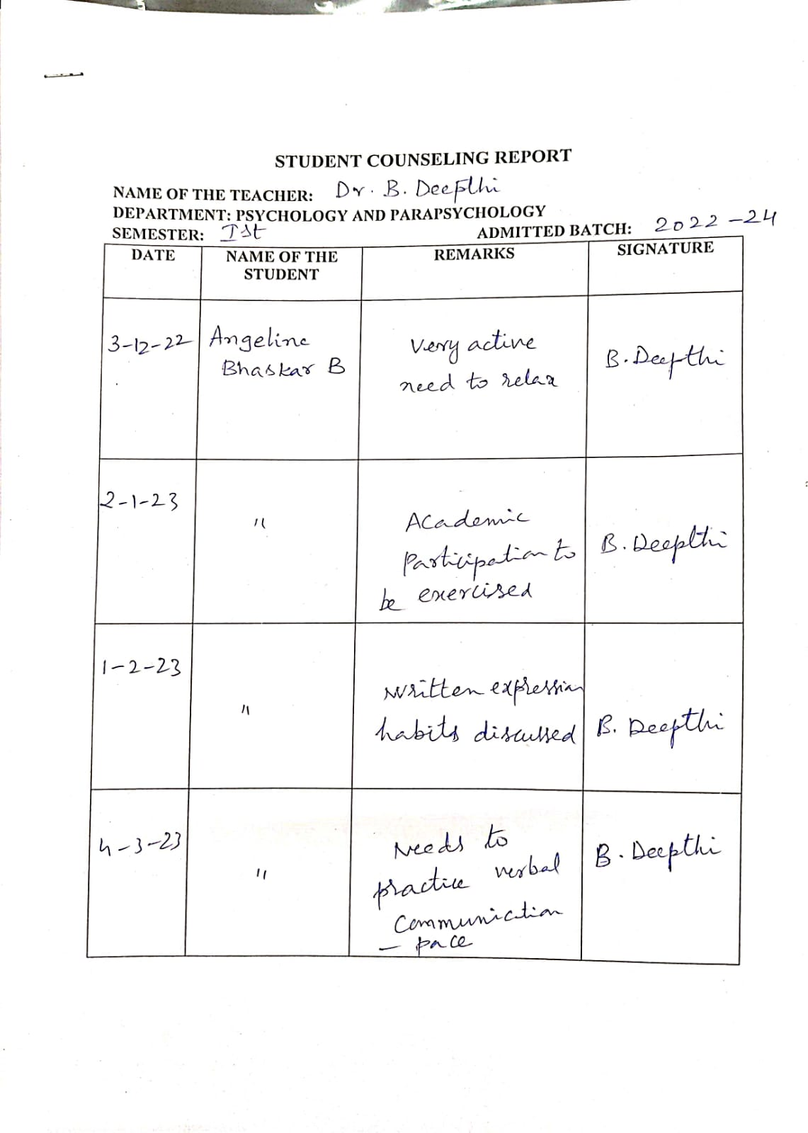
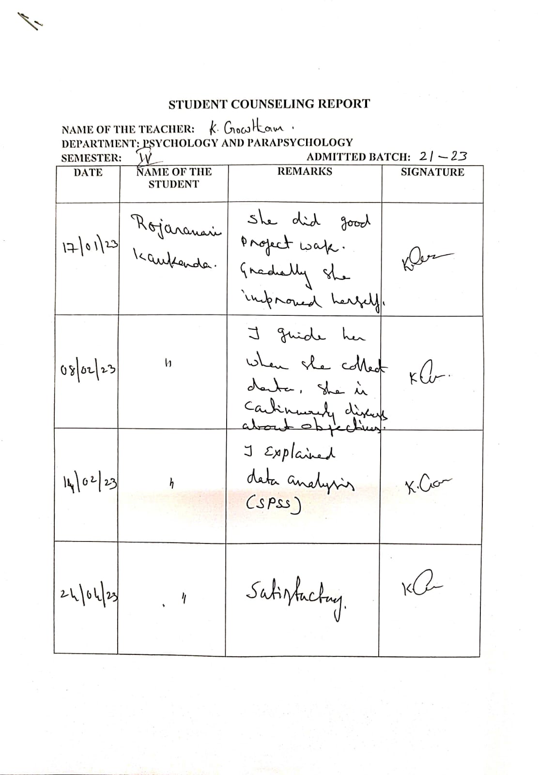
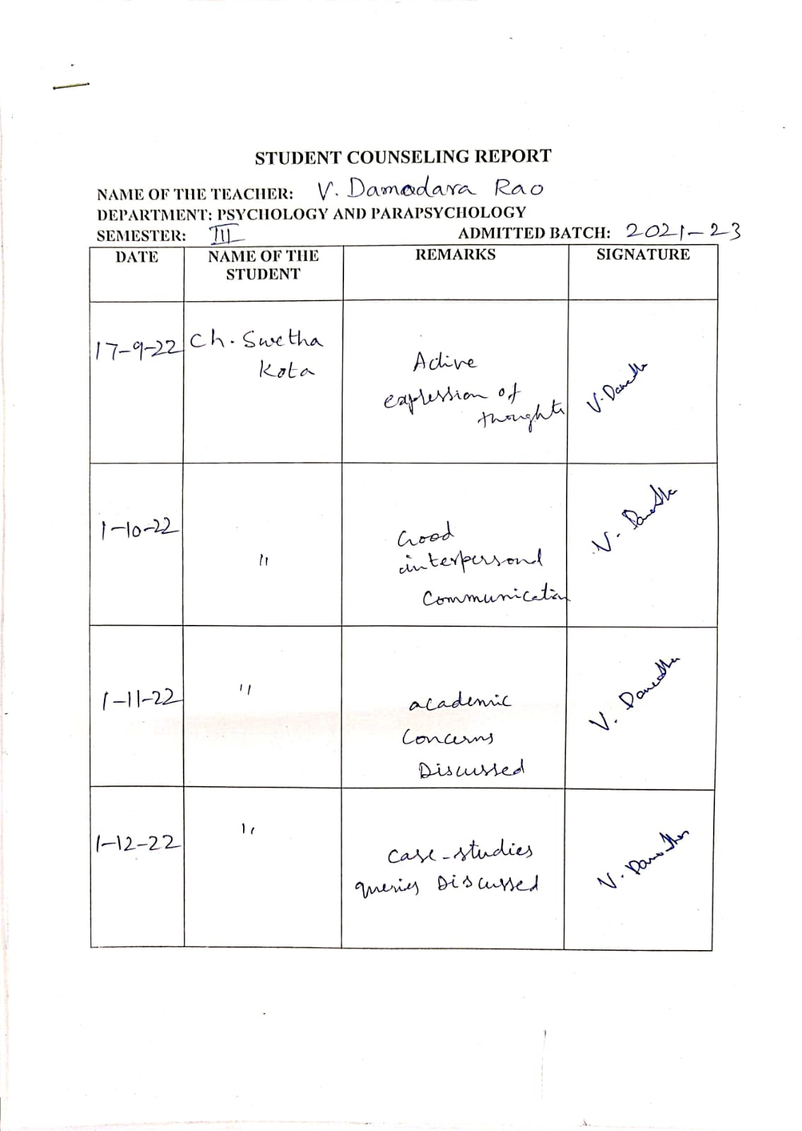
MENTOR/MENTEE SYSTEM:
In each semester students allocated to the faculty for mentoring, so that they have an opportunity to gain practical knowledge and Insight.

Slide 36
AWARDS TO STUDENTS
Academic Year | REGD. NO | Name of the Student | Award Name
2017-2018 | 717202053020 | TEJASWI, KONA | Gold Medal
2018-2019 | 718202053023 | SUSHMA, RAPAKA | Gold Medal
2019-2020 | 719202053019 | PRANAY KEERTAN, TANAKALA | Gold Medal
2020-2021 | 720202053020 | VINEETHA N | Gold Medal
2021-2022 | 721202053015 | SAI RAGA MOUNIKA TUMU | Gold Medal

Slide 37
NATIONAL LEVEL CONFERENCE AWARDS
Academic Year | Name of the Student | Held at | Award Name
2023 | B. HARIKA | IAAP Conference at New Delhi | IAAP
2022 | DRAKSHAYANI | 12th InSPA International Conference at Pondicherry University | InSPA

Slide 38
Academic Year | REGD. NO | Name of the Student | Award Name
2017-2018 | 717202053020 | TEJASWI, KONA | Science Day Award
2018-2019 | 718202053023 | SUSHMA, RAPAKA | Science Day Award
2019-2020 | 719202053019 | PRANAY KEERTAN, TANAKALA | Science Day Award
2020-2021 | 720202053020 | VINEETHA N | Science Day Award
2021-2022 | 721202053015 | SAI RAGA MOUNIKA TUMU | Science Day Award

Slide 39
RESEARCH,INNOVATIONS AND EXTENSTIONS
S. No | Name | Designation | Ph. D Guided | Papers Published | H - Index
1. | Senior Prof MVR Raju | Senior Professor | 29 | 58 | 58
2. | Prof. T. V. Ananda Rao | Professor | 9 | 3 | 3

Slide 40
Workshops/Seminars/Conferences/Symposiums and Training Programs Attended
Academic Year | Workshops | Seminars | Conferences | Symposiums | Training Programmes
2017-2018 | 02 | 08 | 08 | 03 | 14
2018-2019 | 03 | 12 | 12 | 03 | 18
2019-2020 | 03 | 12 | 12 | 01 | 4
2020-2021 | 01 | 03 | 03 | 01 | 3
2021-2022 | 03 | 04 | 04 | 03 | 18

Slide 41
Workshops/ Seminars/ Conferences/ Symposiums and Training Programs Conducted
Academic Year | Workshops | Seminars | Conferences | Symposiums | Training Programmes
2017-2018 | 02 | 02 | 01 | 01 | 3
2018-2019 | 03 | 01 | 02 | 01 | 4
2019-2020 | 01 | 01 | 01 | 01 | 6
2020-2021 | 02 | 01 | 01 | 01 | 4
2021-2022 | 01 | 01 | 01 | 02 | 8

Slide 42
Projects
Ongoing Project:
Navigating Road Safety challenges: promoting mental health and well-being among BPCL Petrol truck drivers, funded by BPCL- 12Lakhs
Project Submitted in ICMR (2023 April): Effect of Yoga and Meditation on the level of Stress, Illness Perception and Well-Being among Diabetic Patients.
PATENTS: COVID – 19 Distress Scale submitted for patent, Application No: 202341088, Patent No: 4088

Slide 43
NO OF JRF/ SRF SCHOLARSHIPS
Academic Year | JRF/SRF
2017-2018 | 05
2018-2019 | 14
2019-2020 | 13
2020-2021 | 09
2021-2022 | 08
POST DOCTROL FELLOWSHIP: 1
Dr. B. Vijaya Bhaskar

Slide 44
DEPARTMENTAL LIBRARY BOOKS
S. No | Department Library Books | GFATM Project Funding Books | Total Books
1. | 423 | 253 | 676

Slide 45
MOUS WITH NATIONAL/INTERNATIONAL INSTITUTIONS
S. No. | Industry/institutions/university | Nature of linkage | Duration (from – to)
1. | Defense Institute of Psychological Research (DIPR), India | Projects, Research, Conferences, Online Journals Research, Projects, Workshops and Teaching Exchange | 27-12-2022 to 27-12-2032
2. | Orange Neurosciences, Canada |  | 31-05-2023 to 31-05-2028
3. | University Hospitals of Geneva | Projects, Research, Conferences, Online Journals and Books Publication | 2009 to till date

Slide 46
SKILL DEVELOPMENT PROGRAMMES
Counseling skills in Hospitals, Disability Institutions Schools, Central Jails and Industries.
Brain Mapping, Behavioural and Clinical skills in Central Bureau of Investigation (CBI), Andhra Pradesh State Forensic Science Service, Juvenile Delinquency and Family Court.
SPSS Advanced Statistics Module
Guidance for UGC NET/SLET/GRE and other Competitive Examinations

Slide 47
DISTINGUISHED ALUMINI
S. NO | NAME OF THE DISTINGUISHED ALUMNI | POSITION
1. | Prof. P V KRISHNA RAO | RETIRED FACULTY, DEPT. OF PSYCHOLOGY AND PARAPSYCHOLOGY, ANDHRA UNIVERSITY, VISAKHAPATNAM.
2. | Prof. V. S. BOSE | RETIRED FACULTY, DEPT. OF PSYCHOLOGY AND PARAPSYCHOLOGY, ANDHRA UNIVERSITY, VISAKHAPATNAM.
3. | Prof. V. S. PRAMILA | RETIRED FACULTY, DEPT. OF PSYCHOLOGY AND PARAPSYCHOLOGY, ANDHRA UNIVERSITY, VISAKHAPATNAM.
4. | Prof. B. SHANTI PRASAD | RETIRED FACULTY, DEPT. OF PSYCHOLOGY AND PARAPSYCHOLOGY, ANDHRA UNIVERSITY, VISAKHAPATNAM.
5. | Prof. V. GOWRI RAMMOHAN | RETIRED FACULTY, DEPT. OF PSYCHOLOGY AND PARAPSYCHOLOGY, ANDHRA UNIVERSITY, VISAKHAPATNAM.
6. | Prof. U. VINDHYA | RETIRED FACULTY, DEPT. OF PSYCHOLOGY AND PARAPSYCHOLOGY, ANDHRA UNIVERSITY, VISAKHAPATNAM.
7. | Prof. P. NIRMALA DEVI | RETIRED FACULTY, DEPT. OF PSYCHOLOGY AND PARAPSYCHOLOGY, ANDHRA UNIVERSITY, VISAKHAPATNAM.
8. | Prof. V. HARI LAKSHMI | RETIRED FACULTY, DEPT. OF PSYCHOLOGY AND PARAPSYCHOLOGY, ANDHRA UNIVERSITY, VISAKHAPATNAM.
9. | Prof. T. V. ANANDA RAO | RETIRED FACULTY, DEPT. OF PSYCHOLOGY AND PARAPSYCHOLOGY, ANDHRA UNIVERSITY, VISAKHAPATNAM.
10. | Prof. P. NIRMALA DEVI | RETIRED FACULTY, DEPT. OF PSYCHOLOGY AND PARAPSYCHOLOGY, ANDHRA UNIVERSITY, VISAKHAPATNAM.
11. | Sri. A. ASHOK | RETIRED FACULTY, DEPT. OF PSYCHOLOGY AND PARAPSYCHOLOGY, ANDHRA UNIVERSITY, VISAKHAPATNAM.
12. | Dr. B. PRASAD BABU | ASSISTANT DIRECTOR IGNOU OPEN UNIVERSITY, VIJAYWADA
13. | Dr. MOUNI SUVARNA RAJU | ASSOCIATE PROFESSOR AND HOD, CENTRAL UNIVERSITY OF ASSAM
14. | Dr. T. KIRAN SINGH | ASSOCIATE PROFESSOR AND CLINICAL PSYCHOLOGY HOD, CENTRAL UNIVERSITY OF MIZORAM
15. | Dr. N. D. S. NAGA SEEMA | ASSOCIATE PROFESSOR, CENTRAL UNIVERSITY OF HYDERABAD
16. | Dr. NAMAGIRI BABJI | RETD. DEPUTY SUPERINTENDENT OF POLICE, AP
17. | Dr. K. V. MOHAN | SUPERINTENDENT, CENTRAL EXCIE DEPARTMENT
18. | Dr. KARUNAKARA PADHY | CHIEF SURGEON CARDIAC, CARE HOSPITALS, VISAKHAPATNAM
19. | Dr. KHAZA RAHAMUTHLLA | SCHOOL MASTER, A. U HIGH SCHOOL, VISAKHAPATNAM.
20. | Dr. K. SUNEETHA | ASSOCIATE PROFESSOR AND HOD, GITAM UNIVERSITY VISAKHAPATNAM.
21. | Dr. ASHA RANI | RETIRED FACULTY AND HOD, GOVT. MAHILA KALASALA, JAILROADM, VISAKHAPATNAM.
22. | Dr. ARUNA SRI | ASSISTANT PROFESSOR, DR. L. BULLAYA COLLEGE, VISAKHAPATNAM.
23. | Dr. D. RAJYA LAKSHMI | ASSISTANT PROFESSOR, ST. JOSEPH COLLEGE, GNANAPURAM, VISAKHAPATNAM
24. | Dr. RUPASELVARAJ | ASSISTANT PROFESSOR, ST. JOSEPH COLLEGE, GNANAPURAM, VISAKHAPATNAM
25. | Dr. B. PAVAN KUMAR | ASSISTANT PROFESSOR, K. L. UNIVERSITY, VIJAYWADA

Slide 48
26. | Dr. B. SIVA SANKAR MANDAL | ASSISTANT PROFESSOR AND HOD, K. L. UNIVERSITY, VIJAYWADA
27. | Dr. M. SALOMI | ASSISTANT PROFESSOR, K. L. UNIVERSITY, VIJAYWADA
28. | Dr. V. V. SATYAMANI | PRINCIPAL, B.Sc. NURSING COLLEGE, KGH, VISAKHAPATNAM
29. | Dr. L. V. RAMANAMMA | ADMINISTRATION OFFICER, CENTURION UNIVERSITY, VIJAJANAGARAM
30. | Dr. K. TARAKA RAMARAO | ASSISTANT PROFESSOR, DEPT. OF YOGA, DR. B R AMBEDKAR UNIVERSITY, SRIKAKULAM
31. | Dr. D. V. VENU GOPAL | ASSISTANT PROFESSOR, IIIT, NUZIVEDU
32. | Dr. N V V S NARYANA | ASSISTANT PROFESSOR (CONTRACT), NANNAYA UNIVERSITY, RAJAMAHENDRAVARAM
33. | Dr. P RAJASEKHAR | ASSISTANT PROFESSOR (CONTRACT), NANNAYA UNIVERSITY, RAJAMAHENDRAVARAM
34. | Dr. Ch. N. K. BHAVANI | ASSISTANT PROFESSOR (CONTRACT), NANNAYA UNIVERSITY, RAJAMAHENDRAVARAM
35. | Dr. K. SRINIVASARAO | MANAGING DIRECTOR, RISALI EDUSENSE INDIA PVT. LTD
36. | Mr. K. SRINIVASA RAO | RETD. AIRFORCE COMMADER, INDIAN AIR FORCE
37. | Dr. D. RAVI SANKHAR | ASSISTANT PROFESSOR, GITAM UNIVERSITY, VISAKHAPATNAM
38. | Dr. R. VIJAYA RAJU | MANDAL DIVISIONAL OFFICER, TANUKU
39. | Dr. G. RAJESWARA RAO | ASSOCIATE PROFESSOR, QIS COLLEGE, ONGOLE
40. | Dr. GUNTI VENKATESWARLU | ASSISTANT PROFESSOR, S. R. R. DEGREE COLLEGE, VIJAYWADA
41. | Dr. SRINIVASA RAO | PRINCIPAL, T. S. R. & E. R. R. DEGREE COLLEGE, PAMARRU, KRISHNA DISTRICT
42. | Dr. MADHU MANJULA | STAFF NURSE, AU SOUTH CAMPUSS HEALTH CENTRE, VISAKHAPATNAM
43. | Dr. SRIMANNARAYANA | PEDIATRIC HOD, AMMALAPURAM
44. | Dr. T. ANNAMMA | PRINCIPAL, NURSING COLLEGE
45. | Mr. K. GOUTHAM | DIRECTOR, RISALI EDUSENSE INDIA PVT. LTD
46. | Mr. SRINIVAS BOKAM | DIRECTOR, BIOWELL PHARMACEUTICALS, HYDERABAD
47. | Mr. K. BHARATH KUMAR | DIRECTOR, RECLAIM PHYSIO HOME, VISAKHAPATNAM
48. | Mrs. D. BHAVANI | CLINICAL PSYCHOLOGIST, DISTRICT EARLY INTERVENTION CENTRE, VIJAYANAGARAM
49. | Mrs. ASLEENA | BEYOND AUTISM CENTRE, ZILLA PARISHAD, VISAKHAPATNAM
50. | Ms. RAMA PATRO | PSYCHOLOGIST, SOFTWARE COMPANY, HYDERABAD

Slide 49
ALMUNI CONTRIBUTION
S. No | Name of the Alumni | Item
1. | Gantla Srinu Babu, M. Sc Psychology Student | 20 wired chairs
2. | T. Srinivasa Rao, Research Scholar | Mic Podium
3. | B. Pavan Kumar | Kent Water Purifier
4. | S. Harsha Sadgun, Research Scholar | Air Conditioner, Espresso Machine, 30 towels for chairs, two board games sets, Entrance Painting Works Renovation
5. | M. Sc Psychology Students 2016-17 Batch (Distance Mode) | Refrigerator
6. | M. Sc Psychology Students 2017-18 Batch (Distance Mode) | 30 Cloth Chairs
7. | Sai Dhana sai Krishna, M. Sc Psychology Student | Seminar Hall Painting Works Renovation
8. | Aparna Kosuri, Research Scholar | Window Curtains
9. | Sushma, M. Sc Psychology Student | 10 Ceiling Fans
10. | Tejaswini, M. Sc Psychology Student | Window Curtains

Slide 50
INTERNATIONAL EVENTS
1. | World Suicide Prevention Day | 10 September
2. | World Alzheimer's Day | 21 September
3. | National Mental Health Awareness Day | 06 August
4. | World Hospice And Palliative Care Day | 10 October
5. | International Day Against Drug Abuse And Illicit Trafficking | 26 June
6. | World Autism Awareness Day | 2 April
7. | World Disability Day | 3 December

Slide 51
NATIONAL EVENTS
1. | Teachers Day | 5 September
2. | Republic Day | 26 January
3. | Independence Day | 15 August
4. | National Science Day | 28 February
5. | Children’s Day | 14 November
6. | Ambedkar Jayanthi | 14 April
7. | Gandhi Jayanthi | 2 October
8. | Womens Day | 8 March
9. | Health | 7 April
10. | Depression | 10 October
11. | Ageing | 1 October

Slide 52
BEST PRACTICES
Therapeutic Approach to Legal proceedings: Counselling for POCSO Offenders
Humanizing Justice : Counselling, Analyzing brain mapping, behaviour & Personality and Reporting in Juvenile Cases
Mentoring the Students to Become Good Professionals In Counseling And Clinical Psychology.
Developing Counseling Skills In Hospital And School Settings
Providing Training Towards Community Health Programs

Slide 53
Future Plan
PG Diploma in counselling and guidance in 2023-24.
PG Diploma in Child Psychology in 2023-24.
MOU A Tender Love & Care, FFA, USA & Department of Psychology and Andhra University.
Projects
Navigating road safety challenges: promoting mental health and well-being among BPCL petrol truck drivers, BPCL

Slide 54
Thank You

